Slide 1
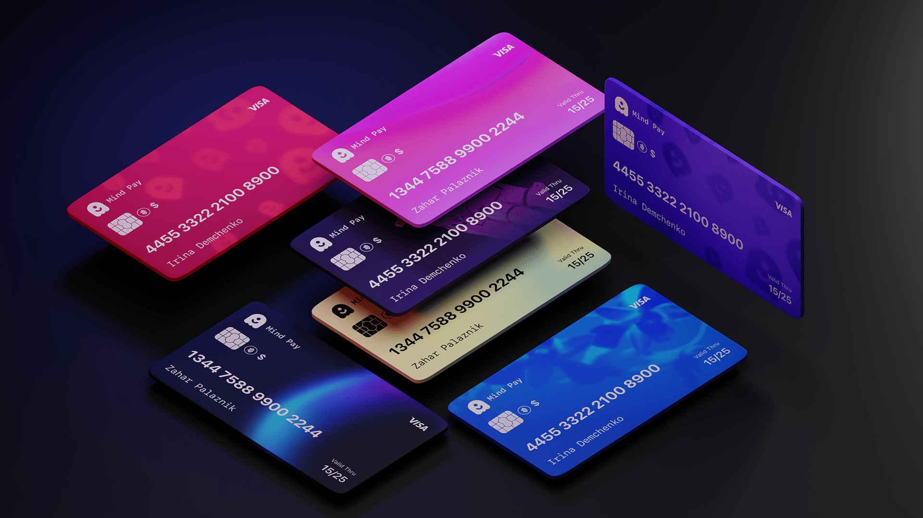
Procurement Card Usage

Slide 2
Agenda
Overview of Application Domain | 3
Difficulties encountered and how we addressed them | 4
Difficulties encountered and how we addressed them | 5
Recommendation of information modelling tool/technique | 6

Slide 3




Team Introduction
Wesley Pereira
Apurva Padwal
3
Saket Naik
Shardul Pharande

Slide 4

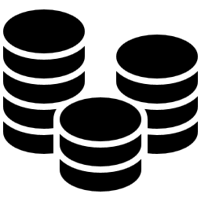

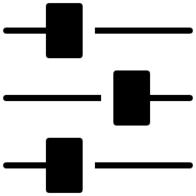

Overview of Application Domain
Procurement cards are a type of company credit card that organizations use to streamline purchasing and expense management processes
Procurement cards offer several benefits, including improved efficiency, increased transparency, and reduced paperwork and administrative costs
However, Procurement cards also come with risks, such as fraud, misuse, and non-compliance with company policies and regulations
To mitigate these risks, organizations need to implement strong controls and monitoring processes, such as transaction limits and regular audits
Automated spend management software can also help organizations gain greater visibility and control over their Procurement card spending
Introduction
Offering
Risks
Mitigation
Monitoring
Procurement cards streamline purchasing and expense management but also pose risks of fraud, misuse, and non-compliance, which can be mitigated through strong controls and monitoring processes

Slide 5


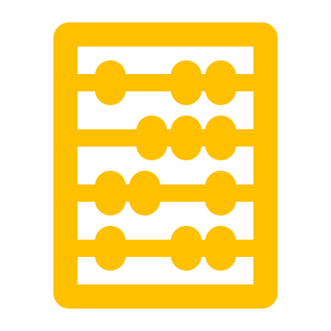
Difficulties encountered and how we addressed them - 1
One of the biggest difficulties that we encountered was the complexity and diversity of transactions and expenses that can be incurred by different departments and employees within an organization
Procurement card transactions are numerous, occur across categories, and involve multiple users with different purchasing behaviors leading to a highly heterogeneous data environment
To address this difficulty, it is important to conduct a thorough analysis of the data environment and identify patterns and trends which can be done through exploratory data analysis
We need to pre-process the data to ensure consistency across different departments and eliminate any anomalies or errors through data cleaning and data normalization
Addressed the difficulties faced by us during modeling
The biggest difficulty in modeling the procurement card usage application domain is collecting and organizing data from multiple sources with varying formats, which can be addressed by implementing a data integration and standardization process

Slide 6
Difficulties encountered and how we addressed them - 2
Another biggest difficulty that we encountered was to accurately identity different entities, relations and attributes and then make an enhanced EERD as the first step in modelling the application for the client
Procurement card involve multiple entities with different behaviors leading to a highly heterogeneous data environment. The complexity of the domain and lack of domain expertise was our main concern
To address this difficulty, it was important to conduct a thorough analysis of the project requirements and the business processes involved in our application. This helped us to gain a better understanding of the domain and identify the key entities and relationships
We need to pre-process the data to ensure consistency across different entities and combine any separate entities (or don’t specialize/generalize them) if there are no unique attributes defining them to maintain uniformity
Addressed the difficulties faced by us during modeling
The biggest difficulty in modeling the procurement card usage application domain is accurately identifying key entities, attributes and relationships which can be addressed by gaining more knowledge about the domain and conduct a thorough analysis of project requirement and initial document

Slide 7
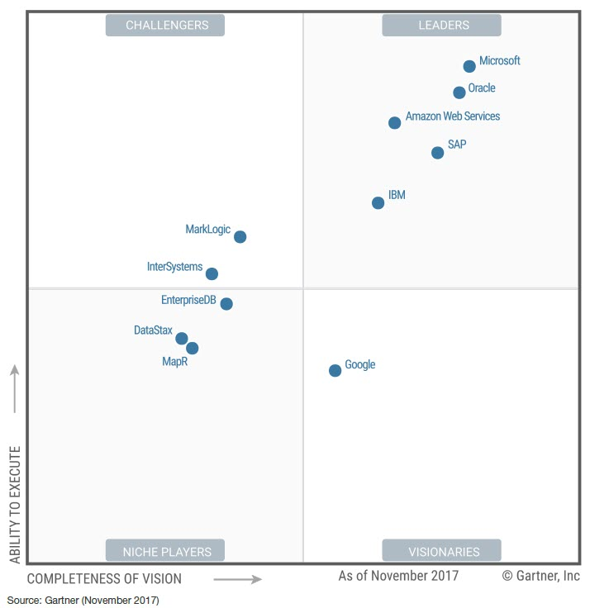
Recommendation of information modelling tool/technique
Our Recommendation is RDBMS that is SQL Server
SQL Server is a great option for large-scale data processing that requires
high availability, elasticity and scaling
Easy integration with Microsoft Operating systems.
Integrated Security (windows authentication): This definitely help
streamline server access based on Active directory policies and groups.
SQL Server has consistently ranked among the top 5 most popular
database management systems for the past few years.
Several built-in analytics features that allow you to perform advanced
data analysis and mining operations, such as:
SSRS (SQL Server Reporting Services)
SSIS (SQL Server Integration Services)
SSAS (SQL Server Analysis Services)
SQL Server is user friendly with built-in analytical functions that can help corporations to efficiently manage and analyse their data
SQLAuthority | TechJury | Gartner

Slide 8
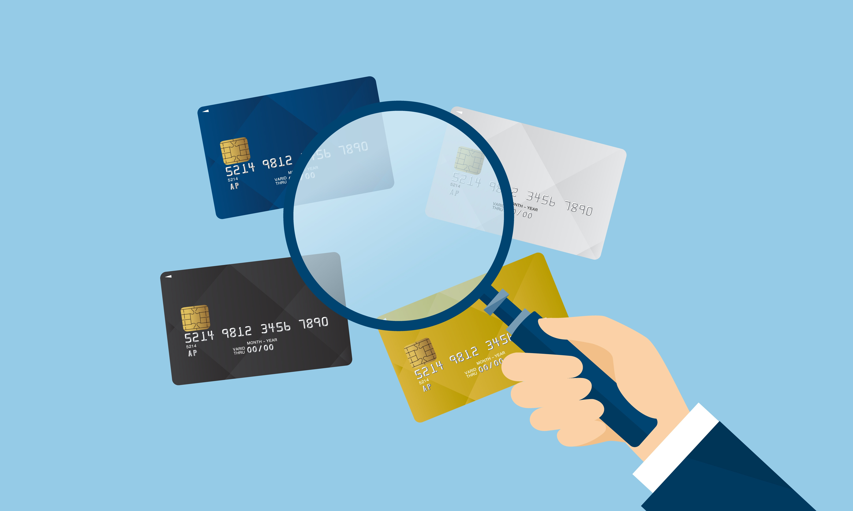
Thank you!

